Slide 1
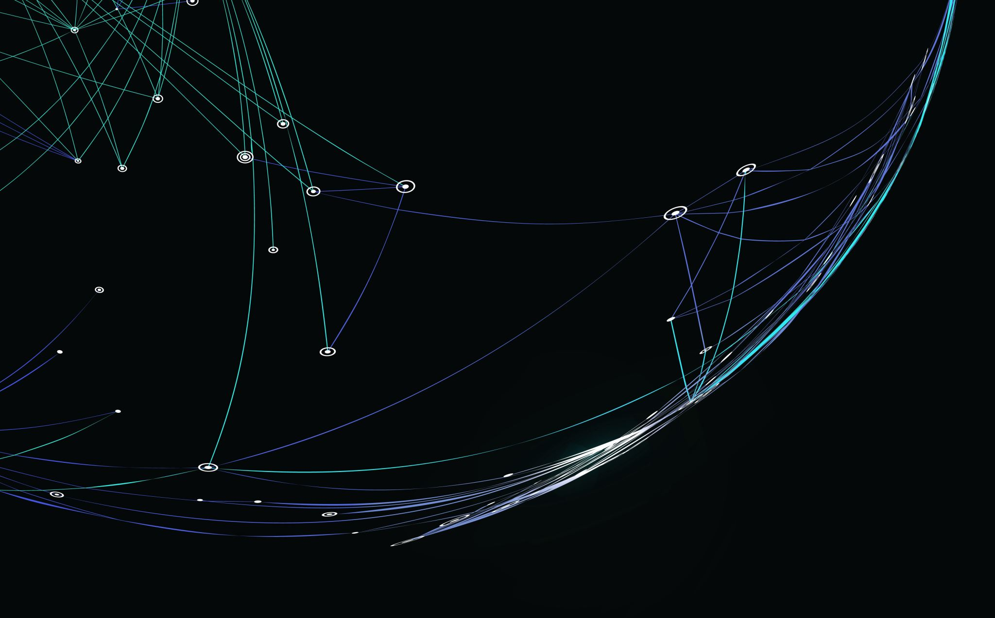
Practical knowledge on Auto ML Tools
-Kapil Panwar

Slide 2
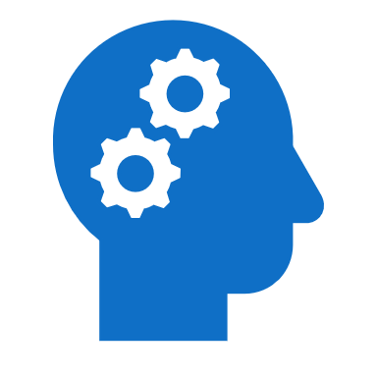
Content
Data Science Project Life Cycle
What is Auto ML
Benefits of Auto ML
Auto ML Frameworks
Let’s Do Some Practical
Can Auto ML replace Data Scientist?

Slide 3
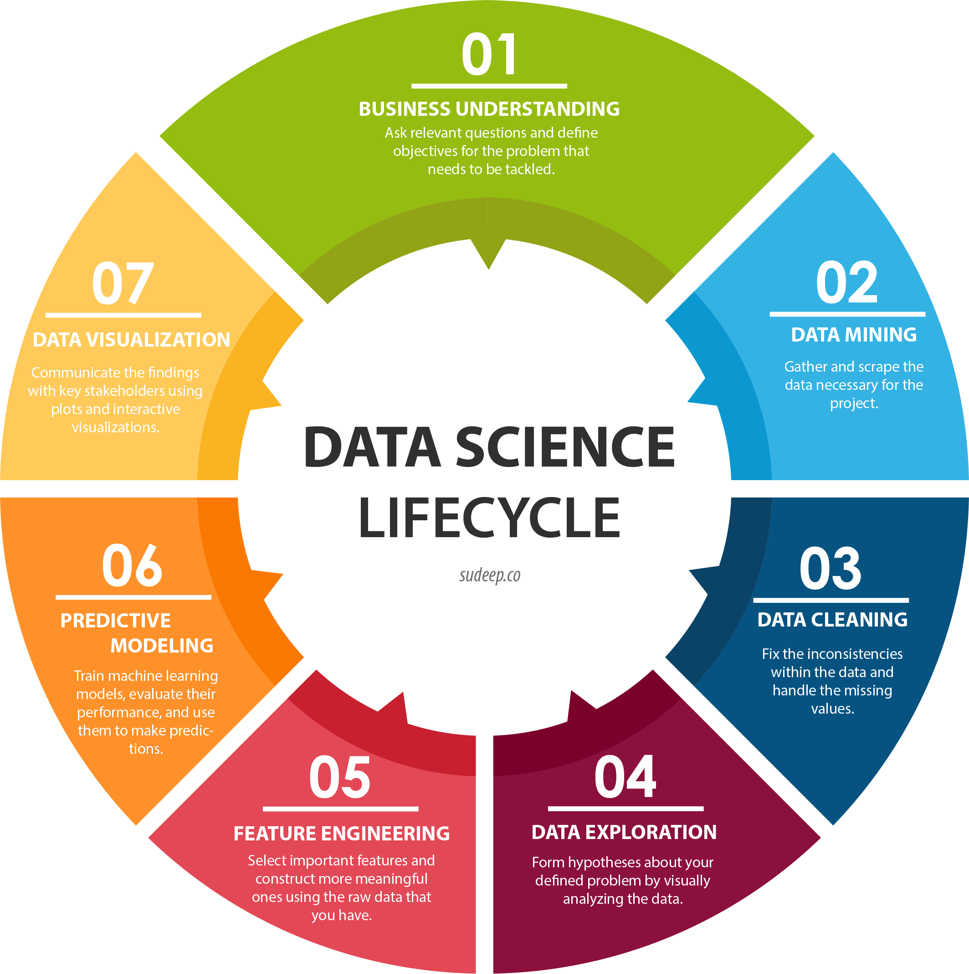
Data Science Project LifeCycle

Slide 4

What is Auto ML and it’s benefits?
Automated machine learning, also referred to as automated ML or Auto ML, is the process of:
Automating the time-consuming
Iterative tasks of machine learning model development.
It allows data scientists, analysts, and developers to build ML models with
High scale
Efficiency
Productivity
Sustaining model
High Quality

Slide 5
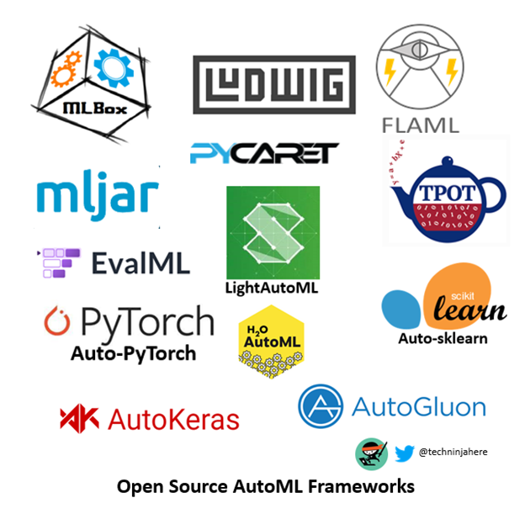
Auto ML Frameworks

Slide 6

PyCaret
PyCaret is a python based low-code machine learning library built on Python, which systematizes machine learning workflows. PyCaret is an end-to-end machine learning and model management tool which exponentially speeds up the experiment cycle and makes you more productive.
PyCaret is an alternative low-code library that can replace hundreds of code lines with only a few words compared to the other open-source machine learning libraries.
PyCaret is fundamentally a Python cover around several machine learning libraries and frameworks such as sci-kit-learn, XGBoost, LightGBM, CatBoost, spaCy, Optuna, Hyperopt, Ray, and several more.

Slide 7
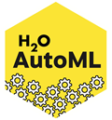
H2O
H2O is an in-memory platform for scalable distributed machine learning. H2O uses acquainted interfaces like R, Python, Scala, Java, JSON, and the Flow notebook/web interface and works flawlessly with big data technologies like Hadoop and Spark.
H2O offers implementations of many popular algorithms such as Generalized Linear Models (GLM), Gradient Boosting Machines (including XGBoost), Random Forests, Deep Neural Networks, Stacked Ensembles, Naive Bayes, Generalized Additive Models (GAM), Cox Proportional Hazards, K-Means, PCA, Word2Vec, as well as a fully automatic machine learning algorithm (H2O AutoML).

Slide 8

LudWig
Ludwig is a toolbox that permits users to train and test deep learning models without writing code, built on top of TensorFlow.
To train a model, we need to provide is a file containing data, a list of columns as an input, and a list of columns as an output; Ludwig will perform the rest for us.
The Linux Foundation hosts Ludwig as part of the LF AI & Data Foundation.

Slide 9
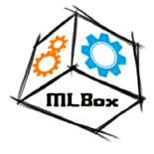
MLBox
MLBox is an influential Automated Machine Learning python library.
It delivers the below capabilities:
Fast scanning and distributed data preprocessing, cleaning and formatting.
Exceedingly robust feature selection and leak detection.
Precise hyper-parameter optimization in the high-dimensional space.
Futuristic predictive models for classification and regression (Deep Learning, Stacking, LightGBM).
Prediction with models' interpretation.

Slide 10

mljar
mljar-supervised is an Automated Machine Learning framework and developed in Python, which works with tabular data. It is intended to save time for a data scientist. It abstracts the standard way to preprocess the data, construct the machine learning models, and perform hyper-parameters tuning to find the best model
The mljar-supervised delivers the below capabilities:
It explains and understands data (Automatic Exploratory Data Analysis),
Explore different machine learning models (Algorithm Selection and Hyper-Parameters tuning),
Create Markdown reports from analysis with details about all models (Automatic-Documentation),
Save, re-runs, and Load the analysis and ML models.

Slide 11
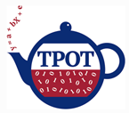
TPOT
TPOT means Tree-based Pipeline Optimization Tool, a Python-based Automated Machine Learning tool that optimizes machine learning pipelines using genetic programming. TPOT is an Assistant to a Data Scientist.
TPOT will automate the most tedious machine learning by intelligently exploring thousands of possible pipelines to find the best one for your data.
TPOT is built beside the scikit-learn framework, so all of the code it generates should look familiar if you’re familiar with scikit-learn.

Slide 12

FLAML
FLAML is a robust AutoML framework with a lightweight Python library that automatically finds accurate machine learning models.
It frees users from selecting learners and hyperparameters for each learner. It is fast and economical, and the subtle and trivial design makes it easy to enhance the features, i.e., adding customized metrics and learners.
FLAML is power-driven by a new, cost-effective hyperparameter optimization and learner selection method invented by Microsoft Research. FLAML leverages the search space structure to choose a search order optimized for both cost and error.

Slide 13
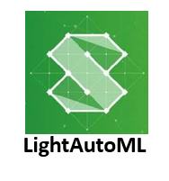
LightAutoML
LightAutoML project from Sberbank AI Lab AutoML group is the framework for automatic classification and regression model creation.
It offers the below capabilities:
binary classification
multiclass classification
regression

Slide 14

EvalML
EvalML is an influential AutoML framework. It builds, optimizes, and evaluates machine learning pipelines using domain-specific objective functions.
Automation: Makes machine learning more reachable. Avoid training and tuning models by hand.
Data Checks: Catches and warns of problems with data and problem setup before modeling.
End-to-end: Paradigms and optimizes pipelines that include state-of-the-art preprocessing, feature engineering, feature selection, and various modeling techniques.
Model Understanding: Offers tools to understand and introspect on models to learn how they’ll behave in the problem domain.
Domain-specific: Comprises repository of domain-specific objective functions and an interface to define own.

Slide 15

Auto-PyTorch
Auto-PyTorch is developed to support tabular data (classification, regression) but can also be leveraged to image data (classification). Auto-PyTorch for tabular data features is described below paper “Auto-PyTorch Tabular: Multi-Fidelity MetaLearning for Efficient and Robust AutoDL.”
The beginning phase of AutoML frameworks is attentive to improving traditional ML pipelines and hyperparameters, and neural architecture search is a recent trend. Auto-PyTorch brings the best of these two worlds together.

Slide 16
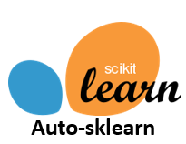
Auto-Sklearn
Auto-Sklearn delivers machine learning developers from algorithm selection and hyperparameter tuning. It influences recent advantages in Bayesian optimization, meta-learning, and ensemble construction. A study paper published at NIPS 2015 more about the technology behind auto-sklearn.
Auto-sklearn 2.0 comprises the latest research on automatically configuring the AutoML system itself and contains many improvements that speed up the fitting of the AutoML system.

Slide 17

AutoKeras
AutoKeras: An AutoML system based on Keras. DATA Lab developed it at Texas A&M University. The goal of AutoKeras is to make machine learning reachable to everyone, and AutoKeras supports several tasks with a straightforward interface.

Slide 18

AutoGluon
AutoGluon automates machine learning tasks enabling you to achieve solid predictive performance in your applications quickly. Developers can train and deploy high-accuracy machine learning and deep learning models on text, image, and tabular with just a few lines of code.

Slide 19
Let's Do Some Practical

Slide 20


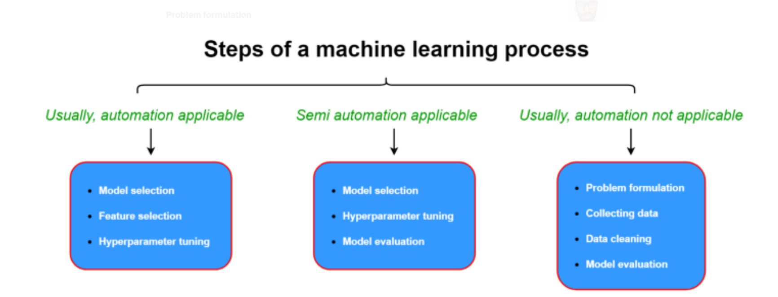
Can Auto ML replace Data Scientist?
Auto ML
Data Scientist
We all know rest of the story

Slide 21



Thank You
+91-8209525160
Panwar.kapil91@gmail.com

